Slide 1
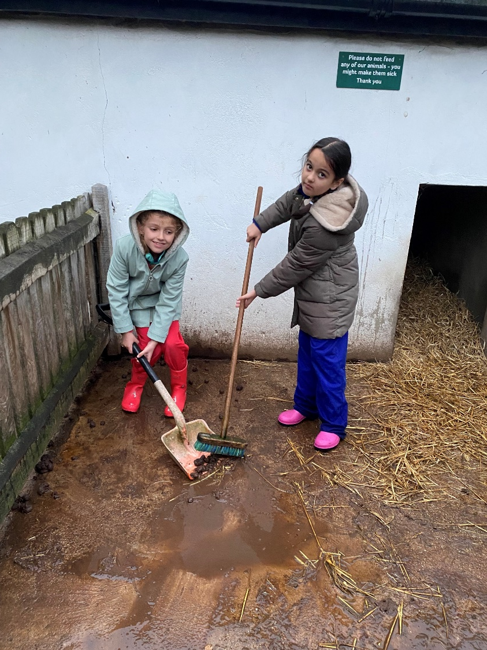
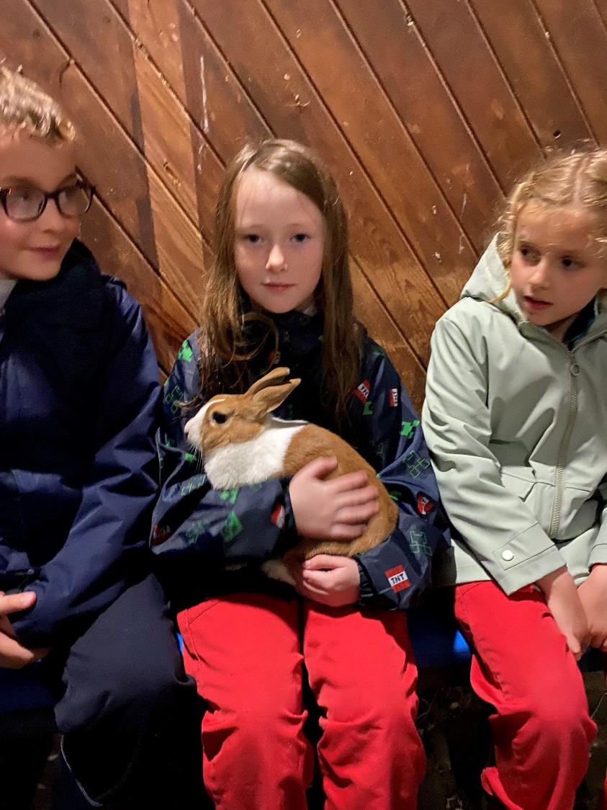
Beaulieu
2024
Dates - children will go on the trip in 1 of 2 weeks:
Either 11th November – 13th November (M, T, W)
Or 18th November - 20th November (M, T, W)
There are 20 boys & 20 girl places each week.
As much as possible, we will group classes together. However, this is dependent on numbers.

Slide 2
The children will be staying on a farm in the New Forest. The centre is run by the Countryside Education Trust.
4 Craneswater staff will be in attendance each week.
Staff are on-call throughout the night.
All medicines will be administered by Craneswater staff.
All dietary requirements are catered for.
Food is freshly prepared each evening.
Packed lunches are provided whilst off site – children will need to bring a packed lunch on the first day along with their own water bottle and sleeping bag (pillows, beds/mattresses and sheets are provided)
For full board, staff led activities and transport, the cost will be approximately £190 (depending on numbers). Please be aware that once your child is offered a place on this residential trip, a non-refundable deposit will be required.
Places are allocated:
First place will go to children who did not attend Hooke Court.
Remaining places will be allocated through names out of a hat.
Any remaining children will be placed on a waiting list.
Beaulieu

Slide 3
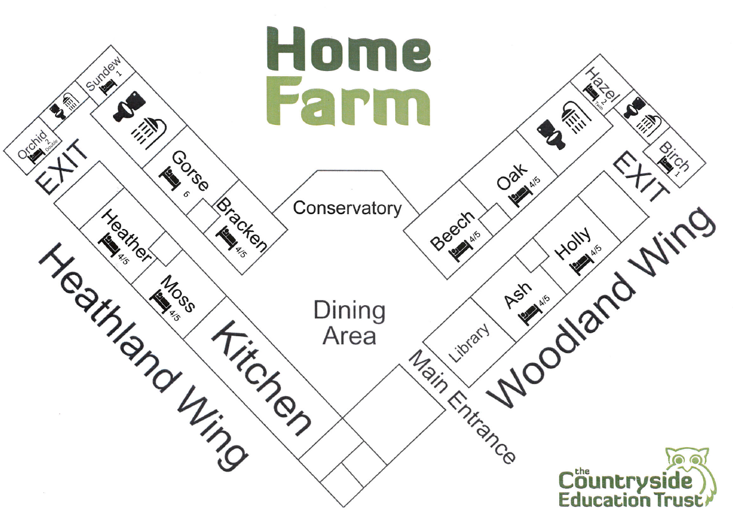
Girls’ corridor and boys’ corridor for sleeping accommodation.
Communal lounge and dining area in the middle.

Slide 4
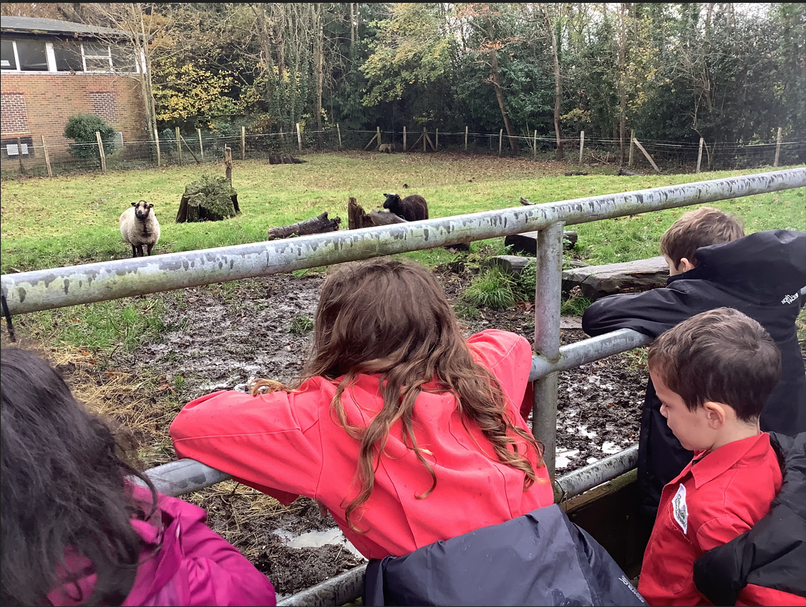
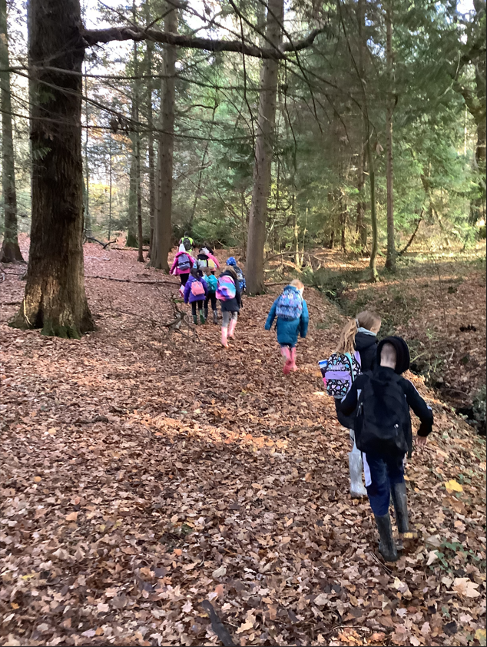
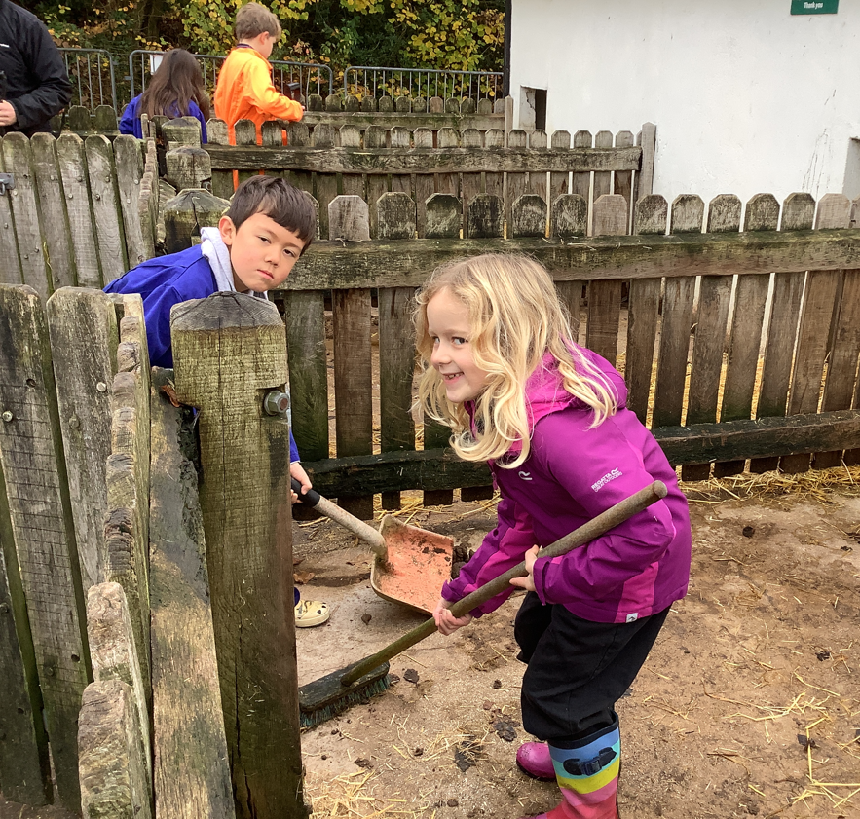
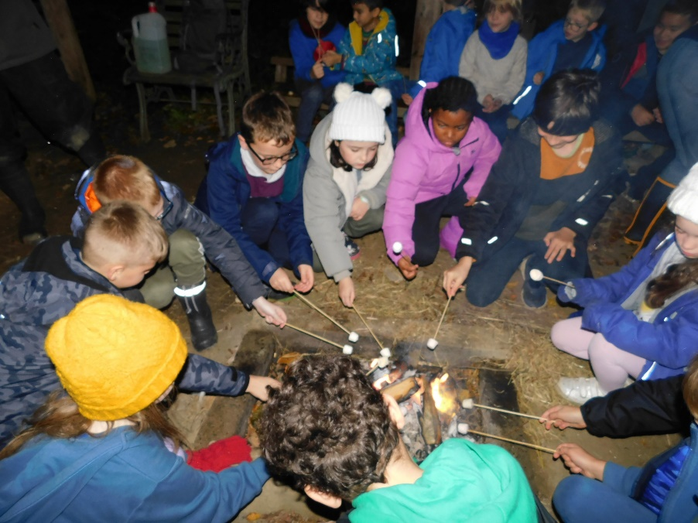
What do we do?
Daily Farm duties
Nature Walk
Orienteering
Pond dipping
Visit to Beaulieu Motor Museum
Campfire night
Visit from a bird of prey expert

Slide 5
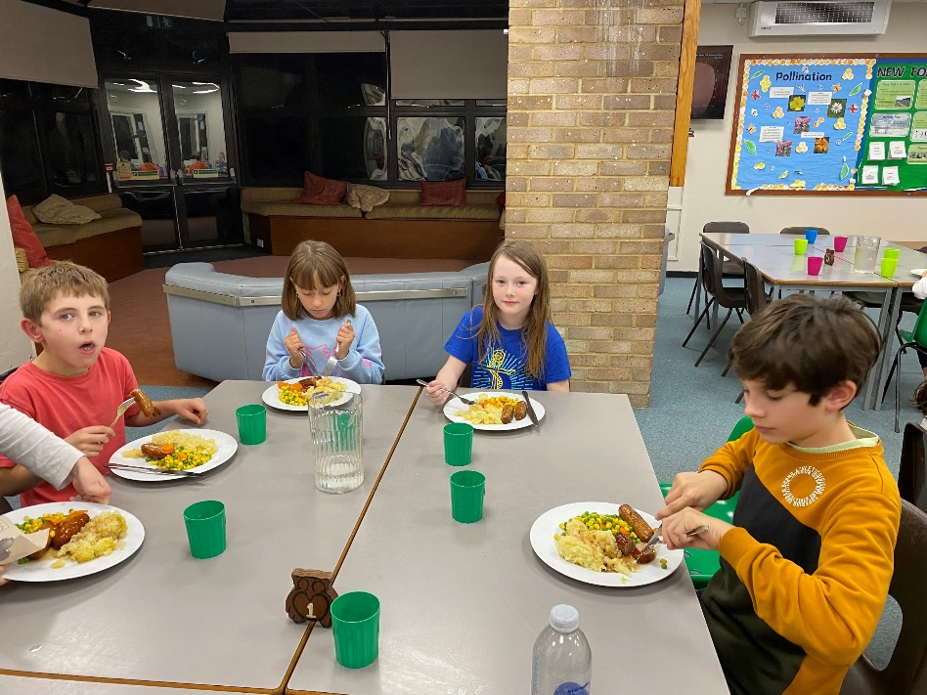
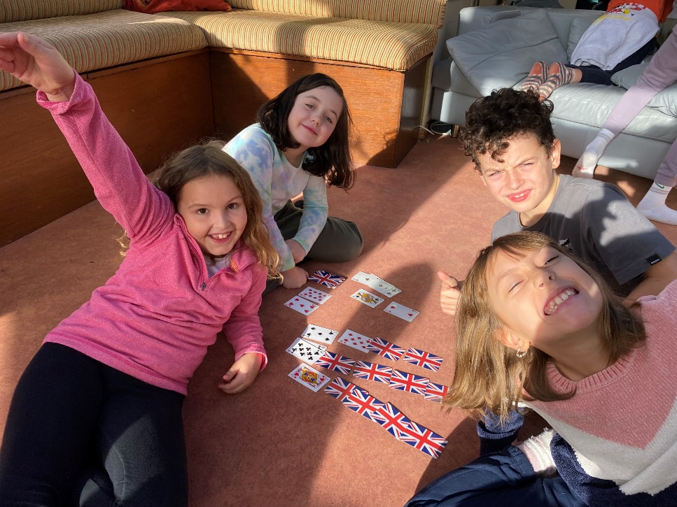
A typical day at Beaulieu...
Get up
Breakfast
Morning farm duties (2 groups)
Trip out / activities
Lunch in the forest treehouse
Afternoon activity
Free time
Evening farm duties (2 groups)
Dinner
Bird of prey talk / campfire
Hot chocolate & snack
Bed

Slide 6
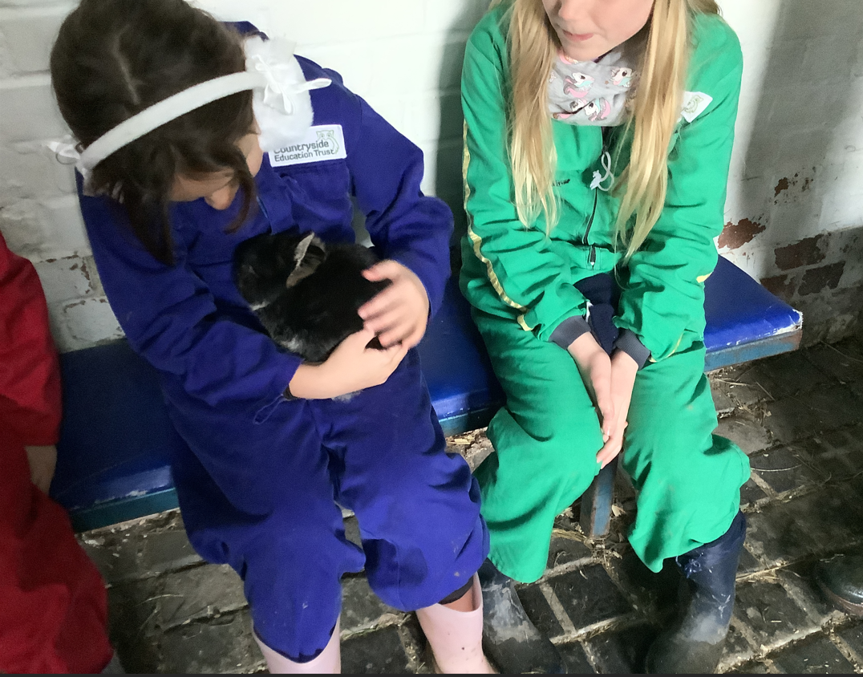
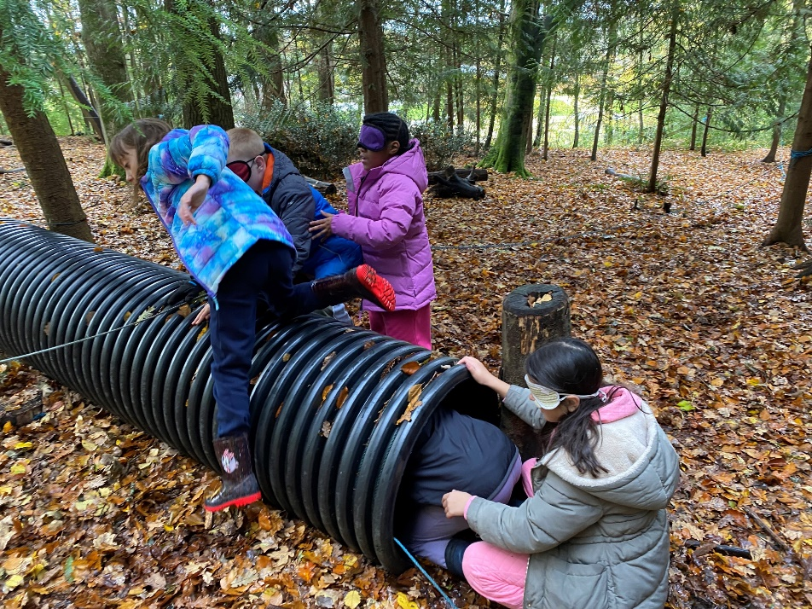
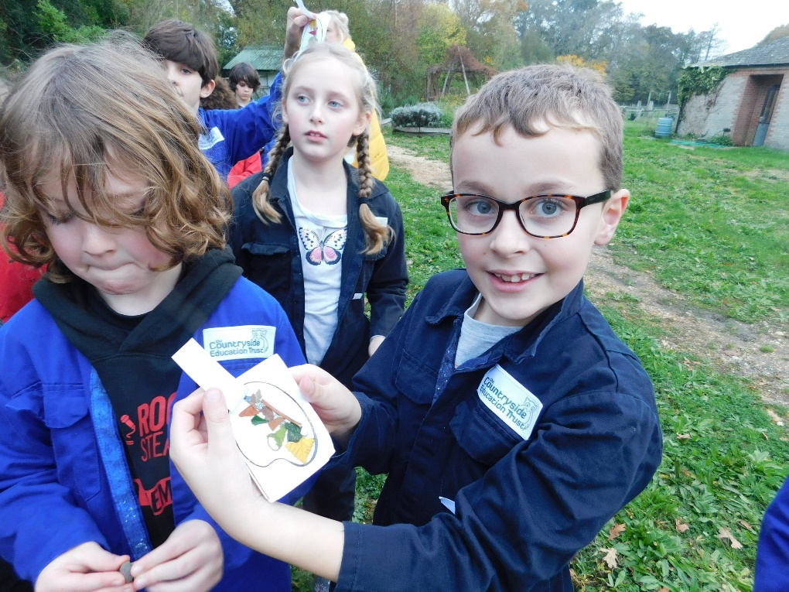
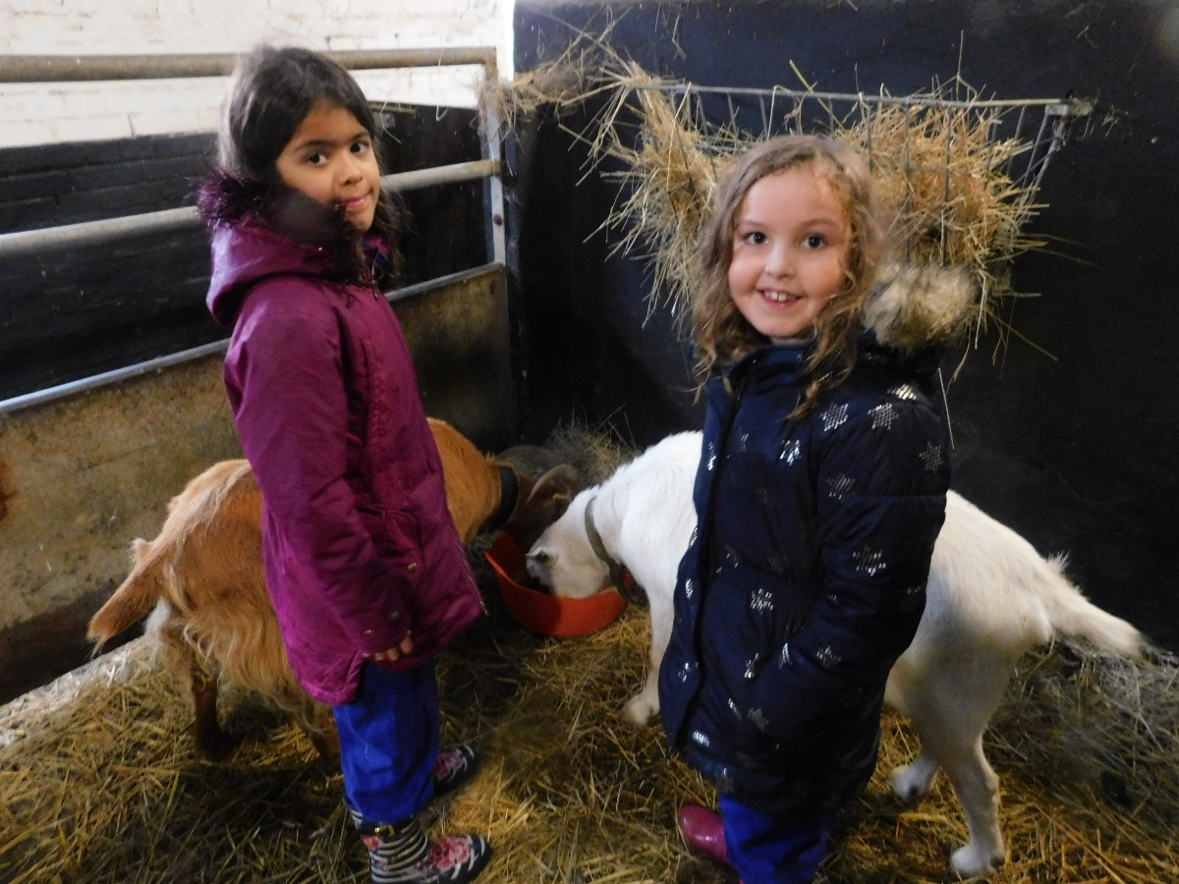
Any Questions?

